Slide 1




KTH IRL (Innovation Readiness Level) metodoloģija BioPhoT projektu komandām
BioPhot mentors Ģirts Ozoliņš
06.10.2025
(English as working language today)
Ilgtermiņa valsts pētījumu programmas projekts “Biomedicīnas un fotonikas pētniecības platforma inovatīvu produktu radīšanai” Nr. IVPP-EM-Inovācija-2024/1-0002

Slide 2

Today's agenda:
10:00 – 10:45 Intro to KTH IRL methodology and application for BioPhot PIP’s readiness level evaluation
10:45 – 11:00 Q&A session

Slide 3
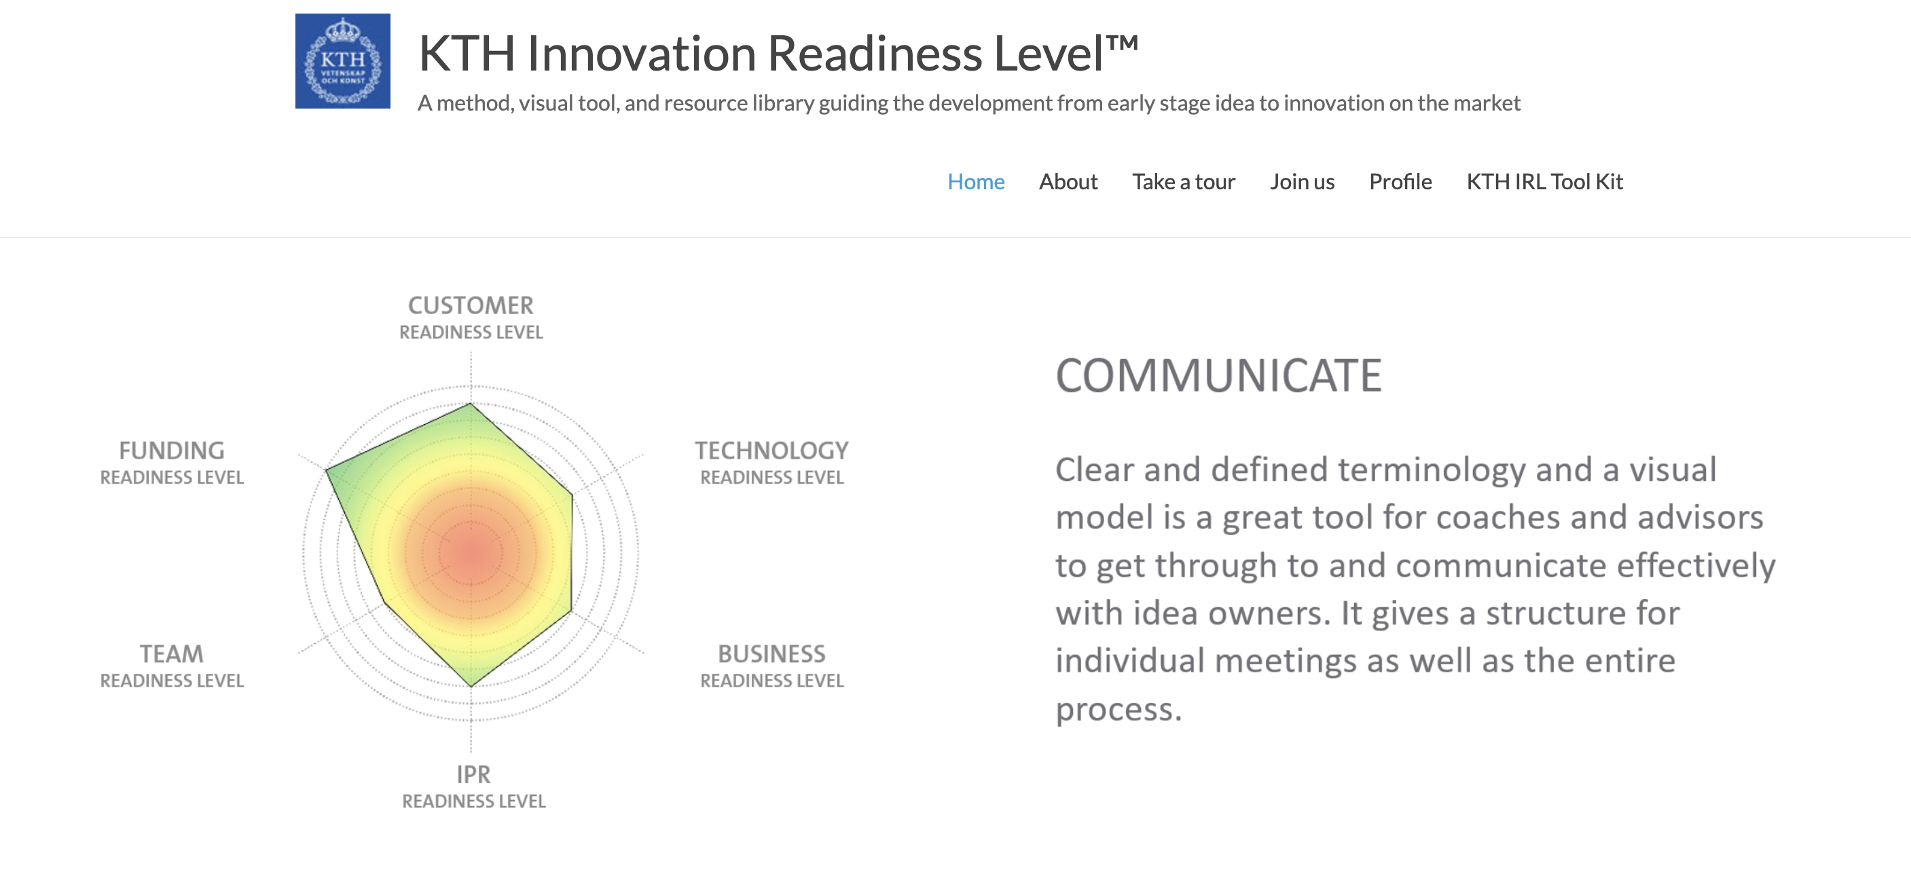

What, why and for whom KHT IRL is used?
KTH Innovation Readiness Level (IRL) methodology was developed by innovation arm of the KTH Royal Institute of Technology (in Sweden) to track, visualize and guide scientific research from early stage idea to innovation on the market.
TTO managers should use this tool…

Slide 4


Slide 5
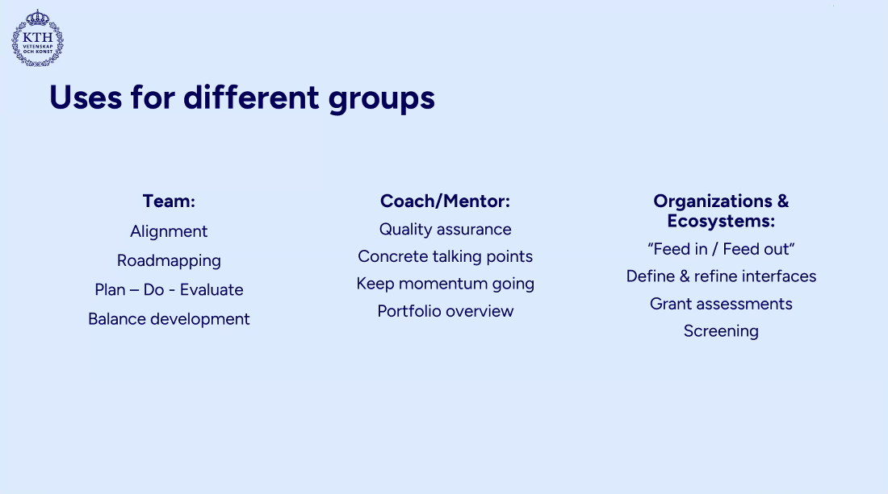
BioPhoT focus

Slide 6

What is KHT IRL and for whom?
For PIP’s

Slide 7
CLICK ADD TO TITLE
USE BAHNSCHRIFT SEMIBOLD FONT 36pt
3 key dimensions of guiding with KTH IRL

Slide 8
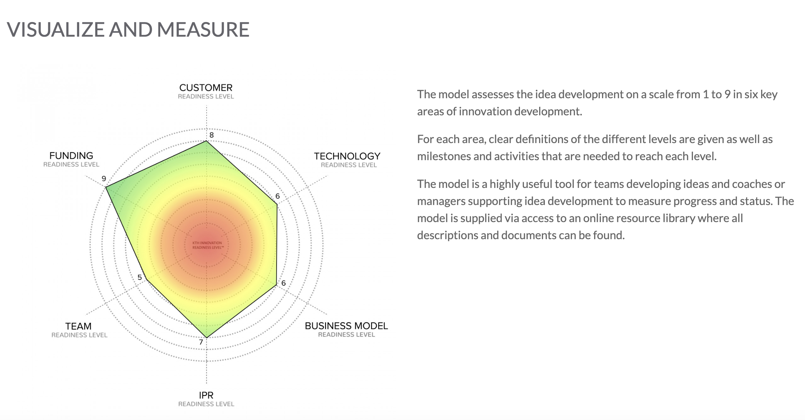
1st dimension
IRL has 6 «legs»!
Researchers usually knows only this area

Slide 9
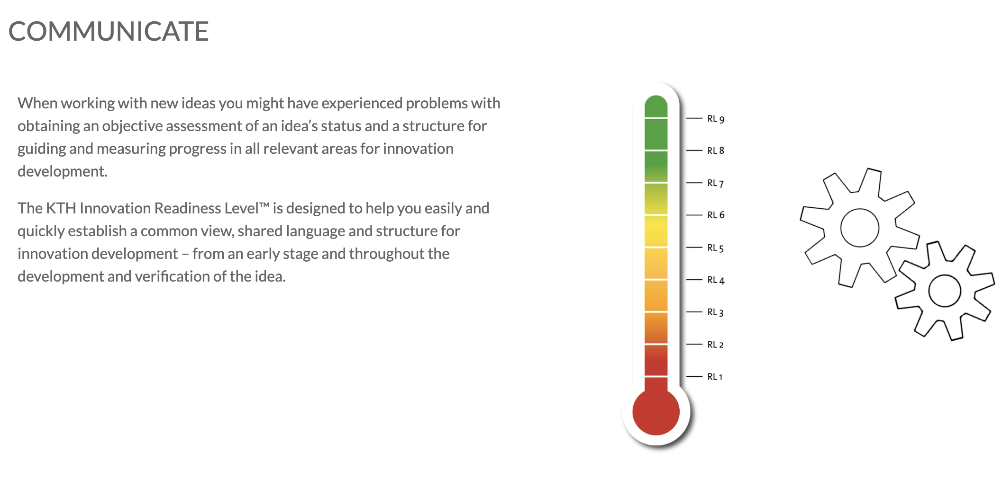
2nd dimension
Common language to explain and assess where are we
Each «leg» has scale 1 to 9

Slide 10
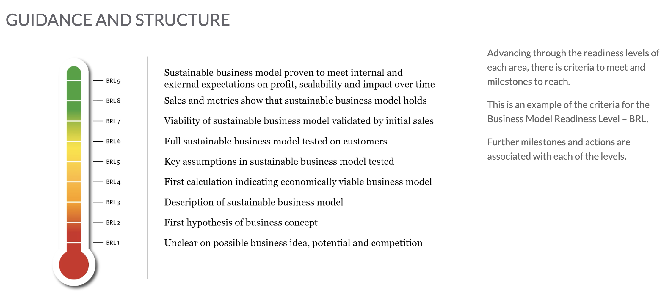
3rd dimension
Common language to understand where are we going and what should we do to get there
Each scale has a precise description

Slide 11
Mentors, PIP’s and KTH IRL
Project mentors are appointed to assist Platform Innovation Project (PIP) teams, guiding and advancing them through the project development process.
Mentors will use KTH IRL methodology, not only for guidance of the BioPhot PIP teams, but also to assess the project development status (including their market potential, team capabilities, intellectual property, and business strategy) and report to BioPhot project management board.

Slide 12
Where KTH IRL is mandatory to be applied in BioPhoT
For mentors there are 3 mandatory IRL evaluations during a PIP implementation: kick-off, mid-term and final
Most important parameter to evaluate and report is TRL!
3x assesments + mentor comments will be taken into account and approved by BioPhoT board
This is done together with the project team/ leader
Kick-off
KTH IRL
evluation
Mid-term
KTH IRL
evluation
Final
KTH IRL
evluation
Month 1
Month 6
Month 12

Slide 13
CLICK ADD TO TITLE
USE BAHNSCHRIFT SEMIBOLD FONT 36pt
IRL SCALES 1 to 9
AND THEIR MEANING

Slide 14
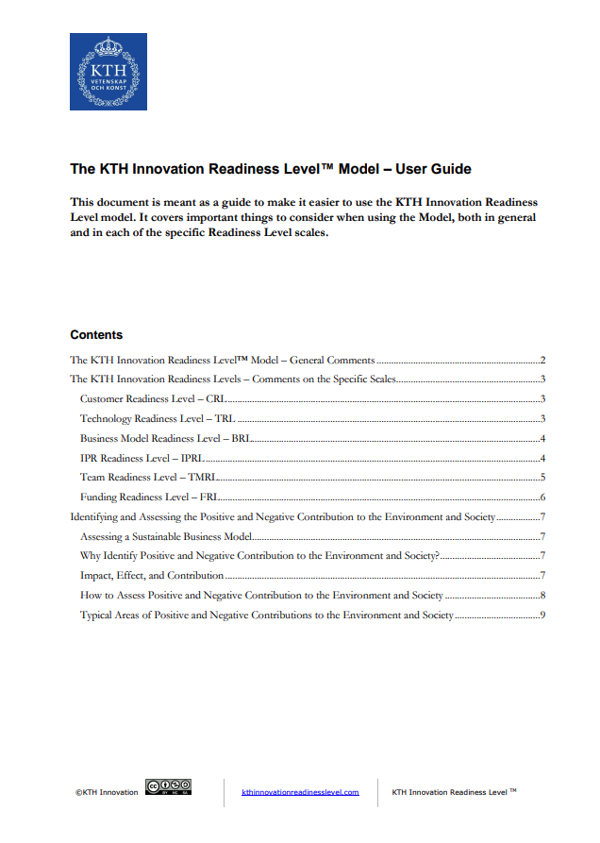
Before we proceed!
It is highly recommended to read additional notes about purpose of methodology and application of 6 readiness levels in the KTH IR – User Guide
Valuable insights only in 9 pages!
User guide + other valuable KTH IRL documents will be available on biophot.lv
CLICK ADD TO TITLE
USE BAHNSCHRIFT SEMIBOLD FONT 36pt

Slide 15
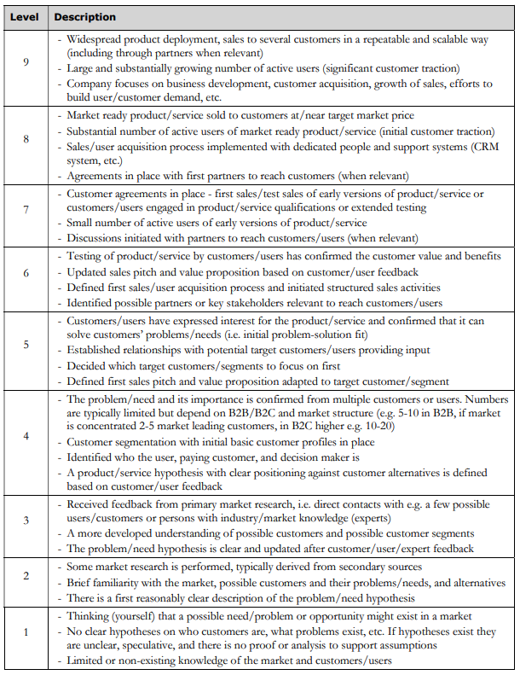
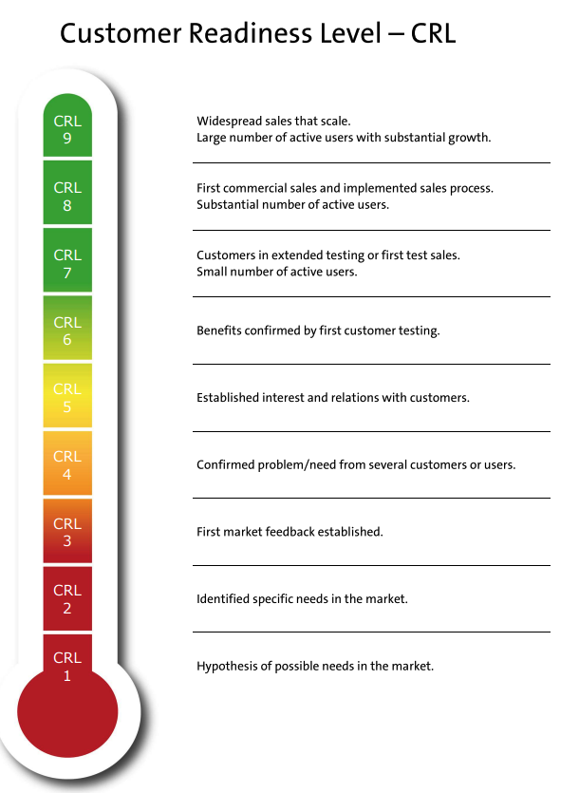
CLICK ADD TO TITLE
USE BAHNSCHRIFT SEMIBOLD FONT 36pt

Slide 16
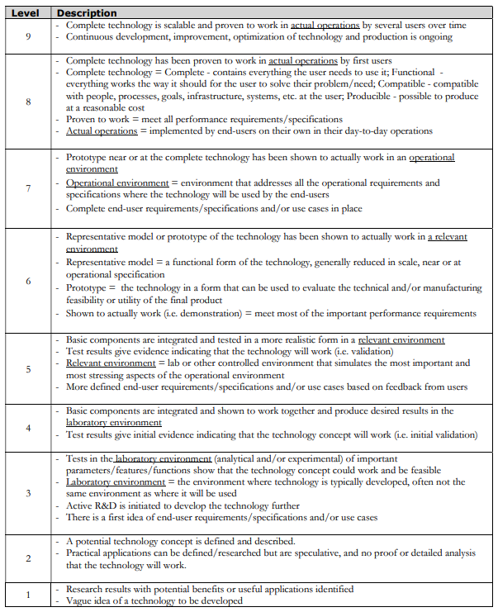
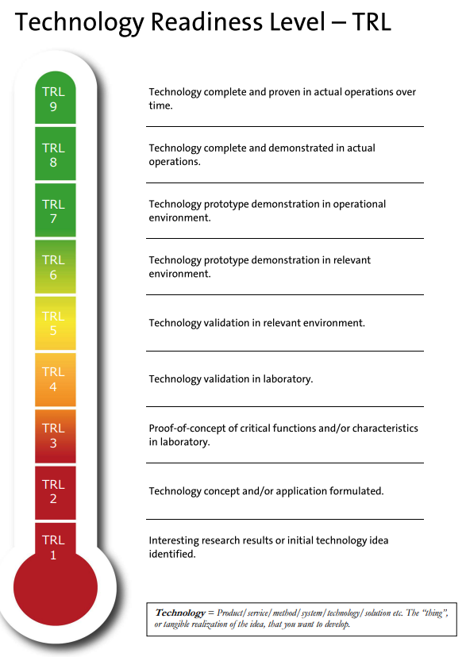
CLICK ADD TO TITLE
USE BAHNSCHRIFT SEMIBOLD FONT 36pt

Slide 17
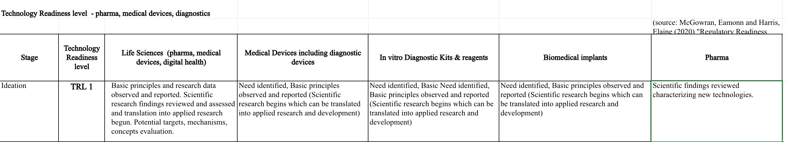
Specific TRL's usage for assessment
To precisely and correctly assess the TRL of BioPhot PIPs which are related to:
Life sciences, medical devices, pharma & diagnostics
Mentors will have to cross-check domain specific TRL descriptions available here.

Slide 18


How to precisely fix at which TRL is my technology currently?
At BioPhot we are counting only fully finished IRL scales (what does it mean?):
I can’t say that I am at TRL 3 unless all the bullet points are finished
If at least one is not finished I am still at TRL 2 the last fully finished level

Slide 19
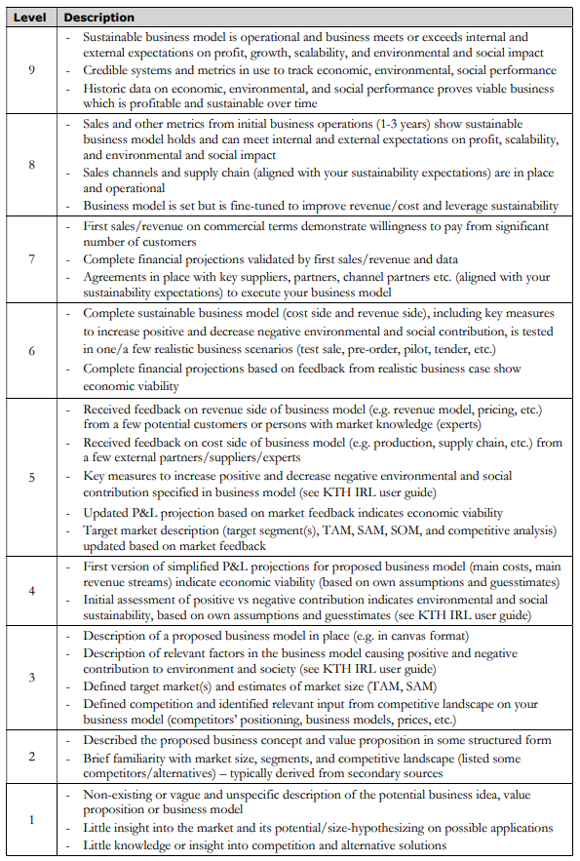
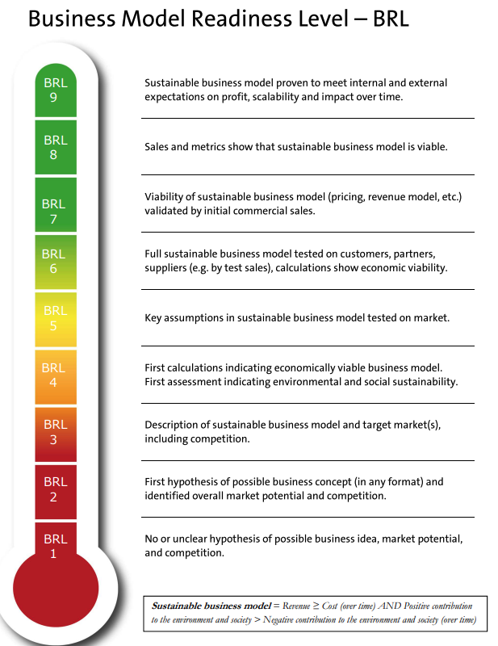
CLICK ADD TO TITLE
USE BAHNSCHRIFT SEMIBOLD FONT 36pt

Slide 20
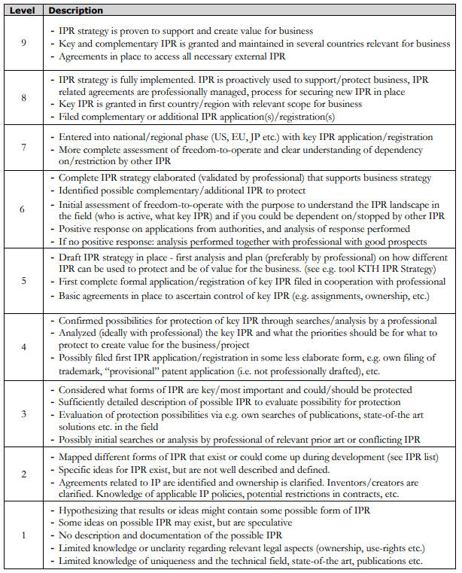
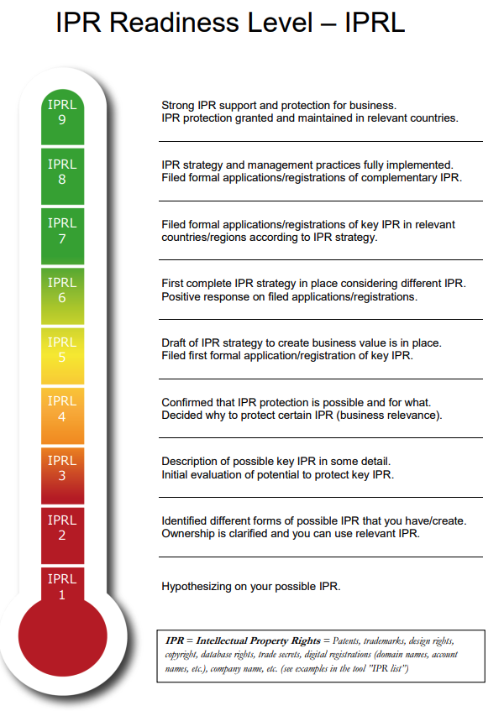
CLICK ADD TO TITLE
USE BAHNSCHRIFT SEMIBOLD FONT 36pt

Slide 21
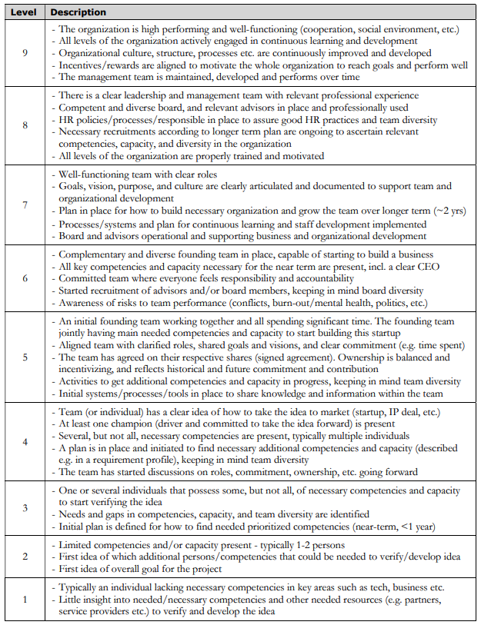
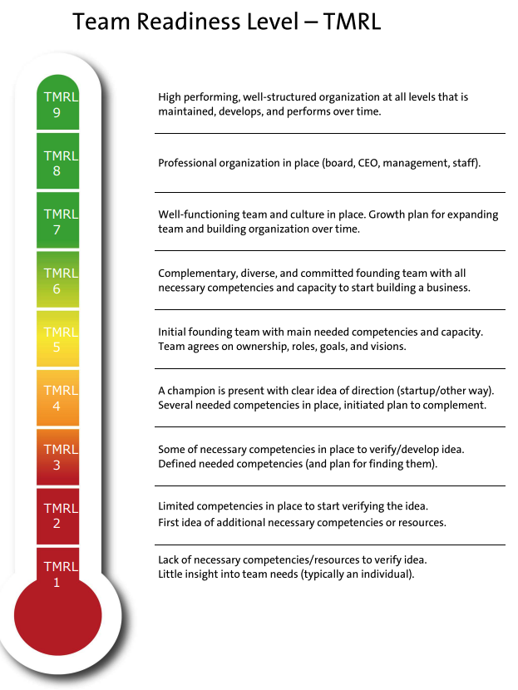
CLICK ADD TO TITLE
USE BAHNSCHRIFT SEMIBOLD FONT 36pt

Slide 22
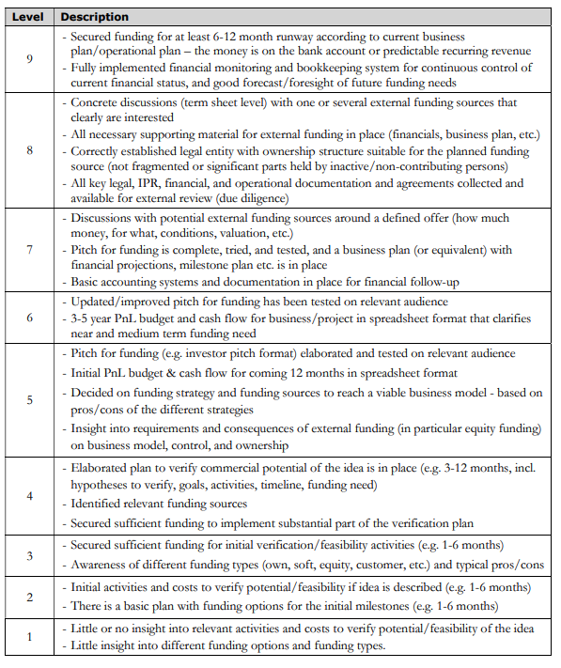
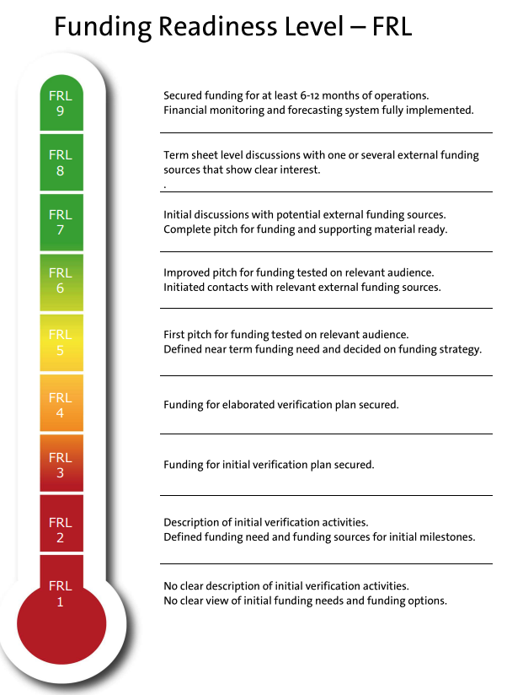
CLICK ADD TO TITLE
USE BAHNSCHRIFT SEMIBOLD FONT 36pt

Slide 23
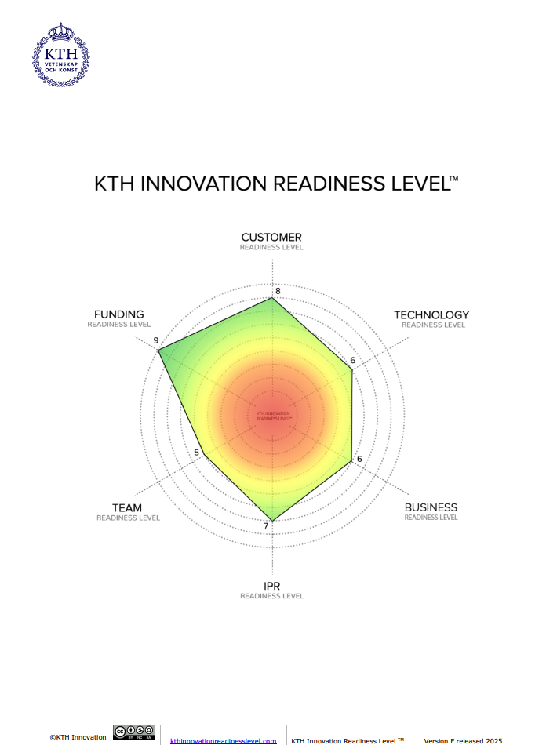
There is a pdf with all 6 IRL’s descriptions, scales and aspects.
Will be available on biophot.lv
CLICK ADD TO TITLE
USE BAHNSCHRIFT SEMIBOLD FONT 36pt

Slide 24
CLICK ADD TO TITLE
USE BAHNSCHRIFT SEMIBOLD FONT 36pt
HOW IT WILL WORK IN PRACTICE?
in BioPhoT

Slide 25
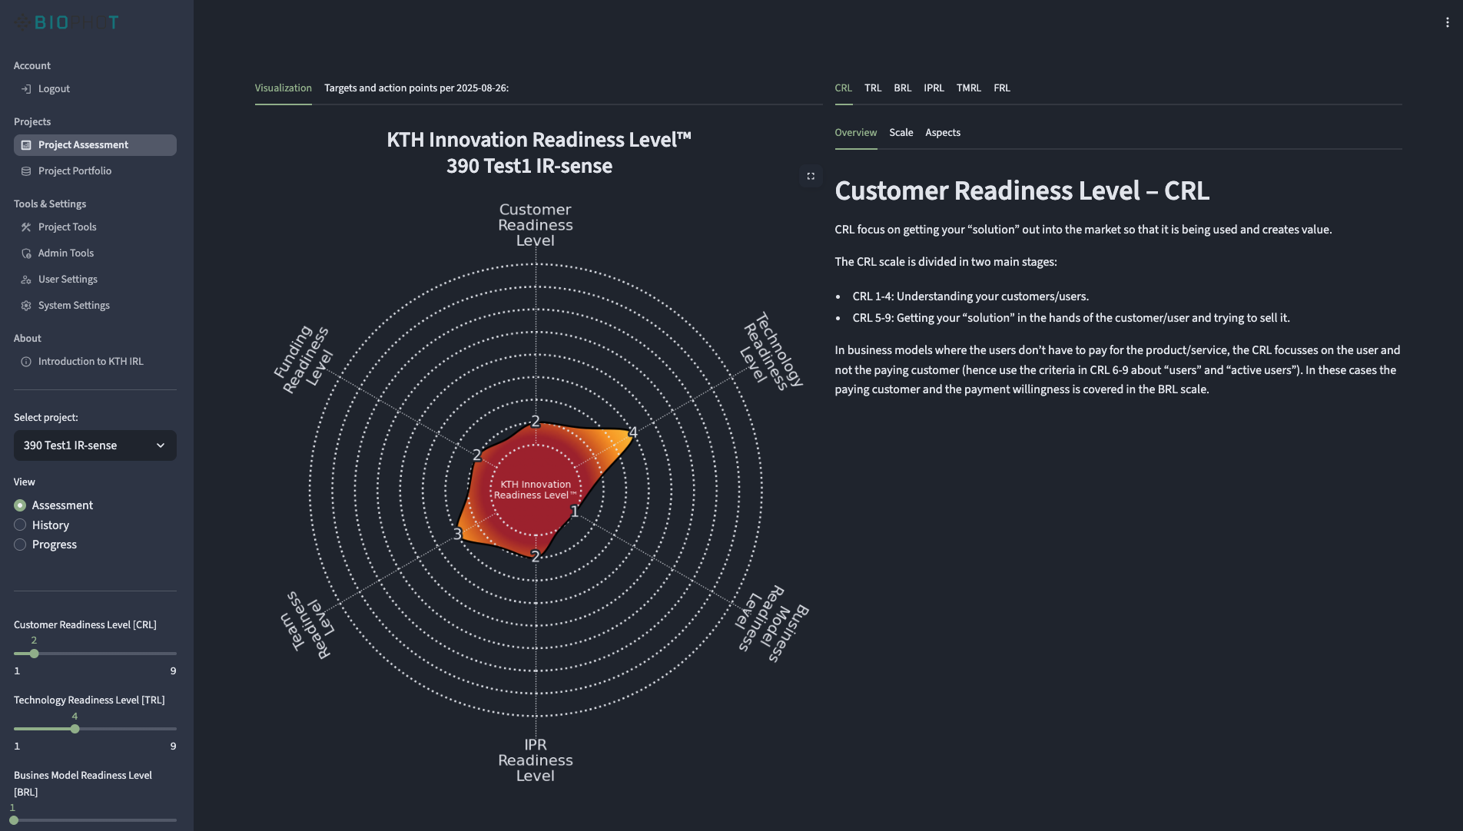
We have created an on-line platform of KTH IRL assessment - https://kth-irl.rtu developed by Mr.Lodve Berre for the TTO of Norwegian University of Science and Technology.
It would eliminate electronic documents and mentors will be able to work and follow PIP teams progress in real-time.

Slide 26
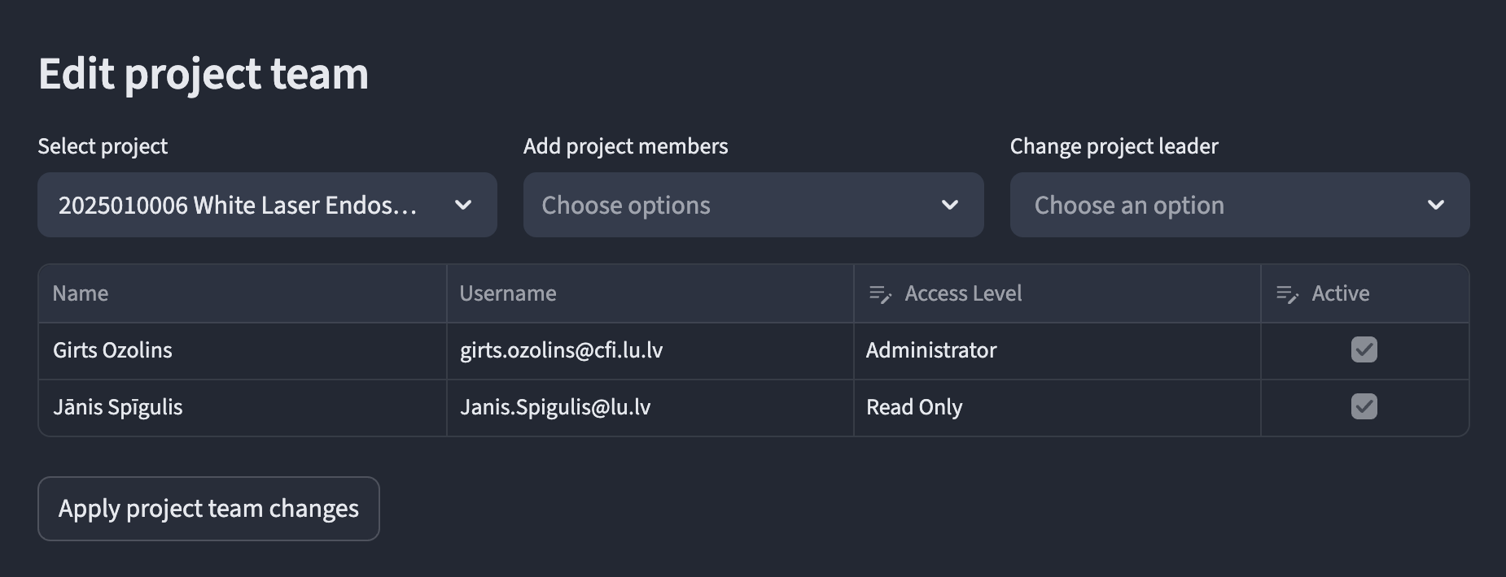
Access to platform is limited and unique user should be created in advance.
Mentors have Administrator rights to put scoring and comments, PIP’s have Read Only rights to see what mentor has added to avoid unattended information changes/updates
To add new user, please write to platform admin:
Ricards.Svitins@rtu.lv or Liene.Ivanova@rtu.lv

Slide 27
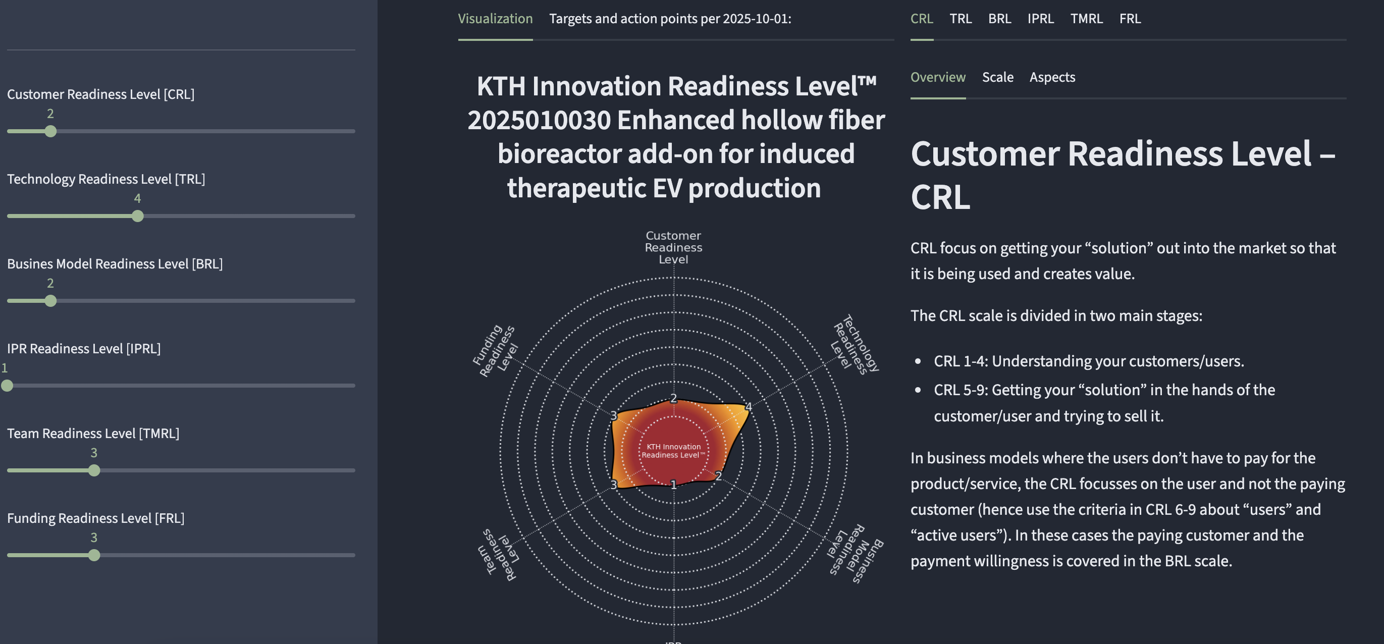
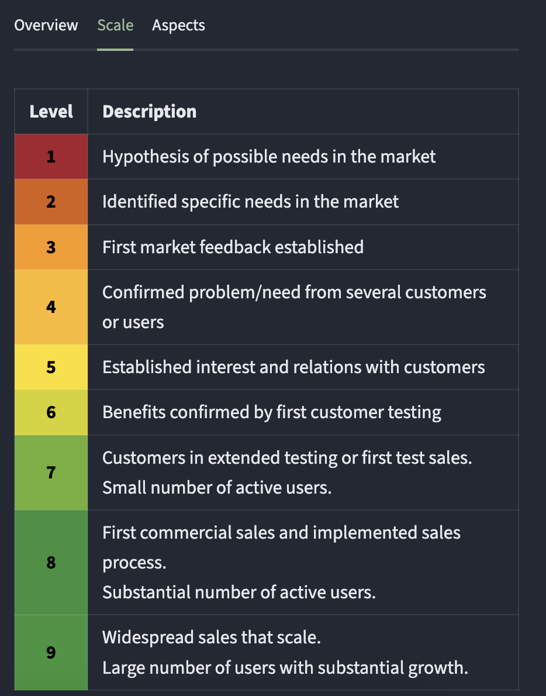
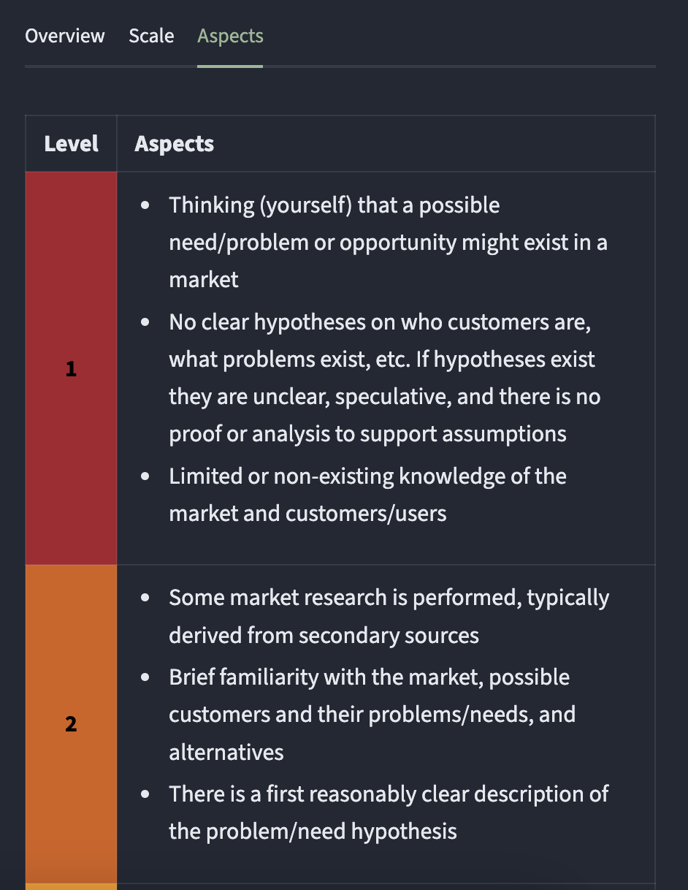
3 easy steps of KTH IRL evaluation:
Step 1 – identify current level
  Go through CRL, TRL, BRL, IPRL, TMRL FRL.
  In each IRL check Scale and Aspects descriptions to be sure where you are
  Discuss with mentor and team, come to agreement & fix current level of 6 IRL’s

Slide 28
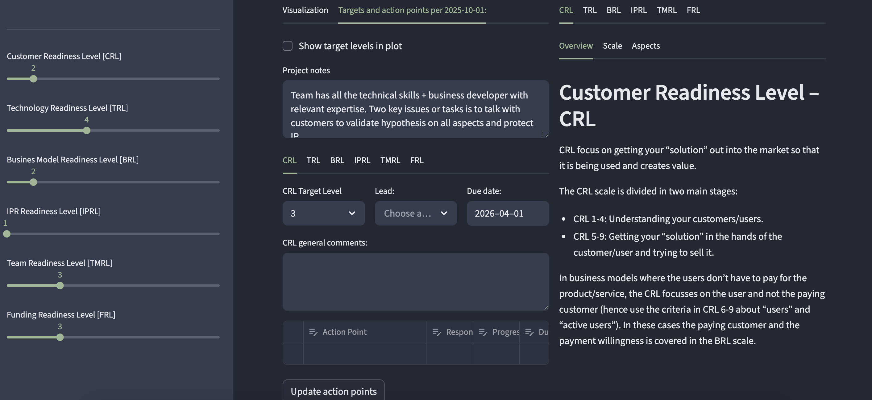
3 easy steps of KTH IRL evaluation:
Step 2 – set target levels
  Click on Targets and action points per [YYYY-MM-DD] tab
  Discuss with mentor and team what are the IRL targets for the next 6 monts on each of CRL, TRL, BRL, IPRL, TMRL FRL
  Based on the Aspects description for each IRL and target think and, if necessary, note down Action Point = Tasks for PIP team members to do.
  In addition mentor will add their own comments for the whole project in Project notes

Slide 29
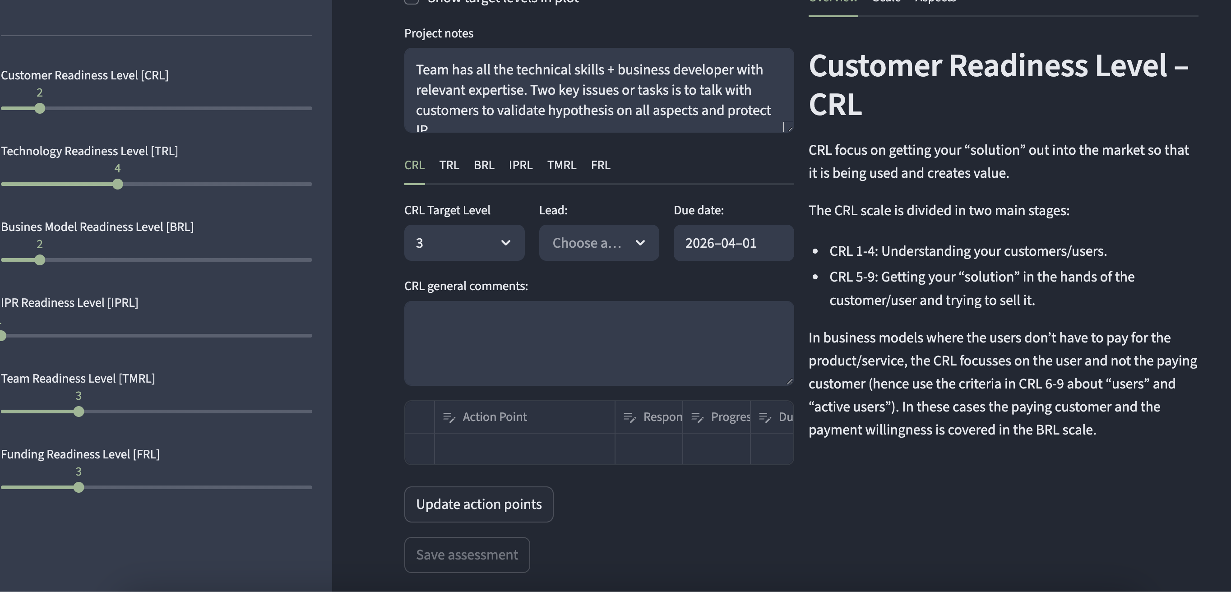
3 easy steps of KTH IRL evaluation:
Step 3 – save the work + make notes on To Do’s until next evaluation or meeting
  Dont for get to save everything until the next KTH IRL evaluation

Slide 30
CLICK ADD TO TITLE
USE BAHNSCHRIFT SEMIBOLD FONT 36pt
NEXT:
Let’s take a real world example what we will do and how it looks in the KTH IRL platform...

Slide 31


Thank you for your attention, questions?
Ģirts Ozoliņš
BioPhot mentor / ISSP UL senior expert innovations
girts.ozolins@cfi.lu.lv

